Slide 1

5.1 - Introduction to Collections
Think of a collection as a container for values.
You can store multiple values in one variable.
Types: Lists, Tuples, Sets
Use case: storing groceries, users, grades, etc.

Slide 2
5.2 - Lists: Creation and Indexing
my_list = [10, 20, 30]
Access with index: my_list[0] → 10
Negative index: my_list[-1] → last item
Lists are ordered and mutable (can be changed)

Slide 3
5.3 - List Methods and Looping
Common methods: .append(), .remove(), .sort(), .reverse()
Looping:
for item in my_list:
print(item)
Use len(my_list) to get size

Slide 4
5.4 - Tuples: Immutable Lists
Tuples use () instead of []
Example: my_tuple = (1, 2, 3)
Tuples are like lists but cannot be changed
Good for fixed data: coordinates, settings, etc.

Slide 5
5.5 - Sets: Unique and Unordered
Sets use {} or set()
No duplicates, unordered
Example: my_set = {1, 2, 2, 3} → {1, 2, 3}
Useful for removing duplicates or checking membership

Slide 6
5.6 - Converting Between Types
list(), tuple(), set() can convert collections
list('abc') → ['a', 'b', 'c']
set([1, 2, 2]) → {1, 2}
tuple([1, 2]) → (1, 2)

Slide 7
5.7 - Membership Tests
Use in/not in to check if value exists
'apple' in ['apple', 'banana'] → True
3 not in (1, 2, 4) → True
Sets are optimized for fast membership checks

Slide 8
5.8 - Project Lab: Student Roster System
Create a program to manage a class roster:
- Add/remove students
- View current list
- Prevent duplicates using a set
Use functions and a looped menu system

Slide 9
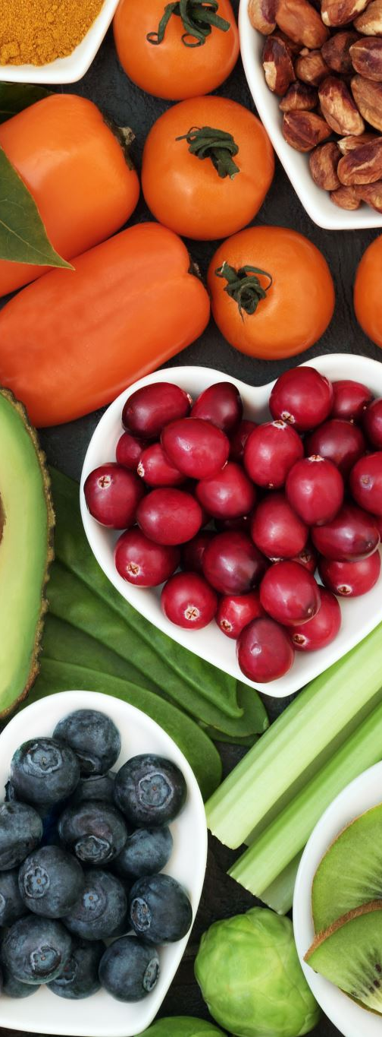
5.9 - Review and Challenge
✅ What’s the difference between a list and a tuple?
✅ What does set([1,2,2,3]) return?
Challenge: Write a program to track a set of favorite foods
Let the user add/remove foods and print the final list

